Slide 1
Why HIV prevention programs succeed or fail
Session: Bending the curve - Modernizing HIV prevention through balanced curation of interventions

Slide 2
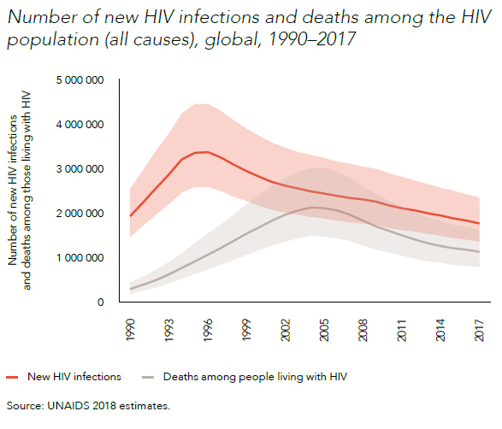
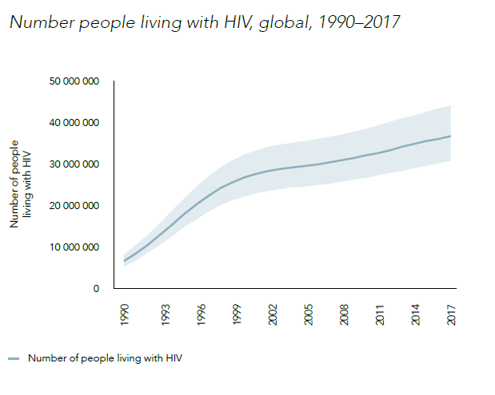
State of HIV
HIV Mortality and HIV incidence are
decreasing
BUT total number of people with HIV is
rising

Slide 3
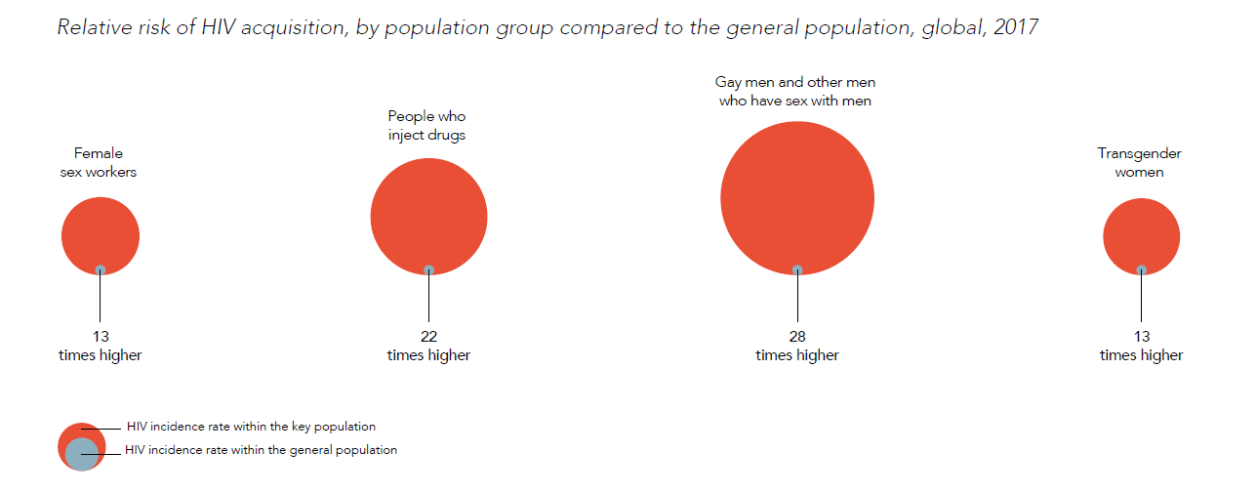
Rising infections in populations left behind
Key populations – account for 40% of new infections, systematically marginalized.
Young Men – low knowledge of HIV status, low service utilization
Adolescent girts and young women – low knowledge of HIV status and disproportionate infection rate, limited service access, sexual activity stigmatized
PWID
MSM
FSW
TGW

Slide 4
But there are examples of successful scaled prevention
- What can we learn from them?

Slide 5
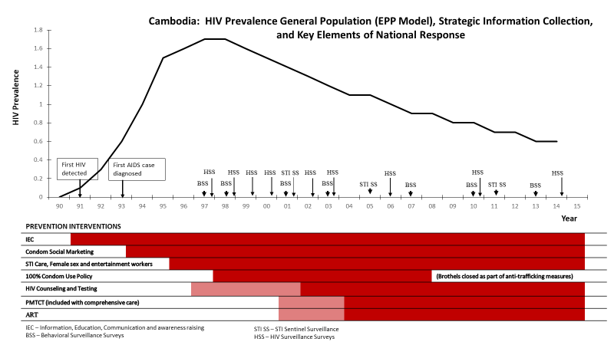
Successfully Scaled HIV prevention programs
Cambodia
Some Elements of Success:
Understanding of epidemic – fueled by sex work
Collection and use of data and responsive program (government and civil society) – mapping of brothels, frequent assessment of outcomes, expanding response
Multisectoral response managed under the National AIDS authority
Structural interventions

Slide 6
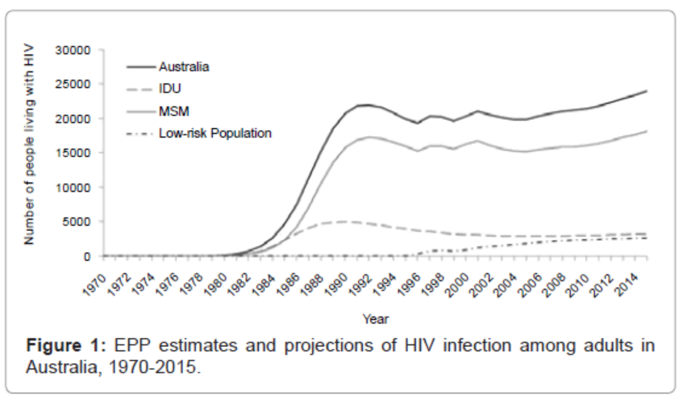
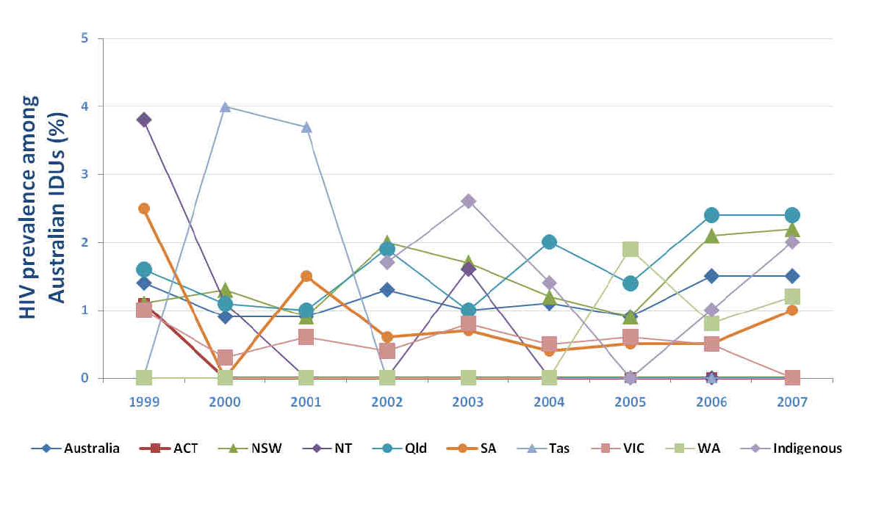
Successfully Scaled HIV prevention programs
Australia
Some Elements of Success:
Early response to IDU transmission – first isolated harm reduction interventions and then adopted as national program in late 1980’s
Collaboration between civil society and public health sector
Government funding supporting NSP at sufficient quantity through dedicated services or through clinical services
Free NSP in 800 locations
Subsidized purchase in 3000 pharmacies
Over 100 vending machines across the country

Slide 7
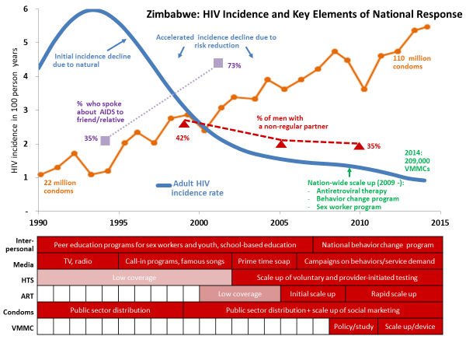
Successfully Scaled HIV prevention programs
Zimbabwe
Some Elements of Success:
Government ownership
Strong health system and community response
Routine ANC data from 1990
Multi-sectoral response
High coverage of personal, mid- and mass media in early 1990
Widespread public sector distribution and social marketing of condoms

Slide 8
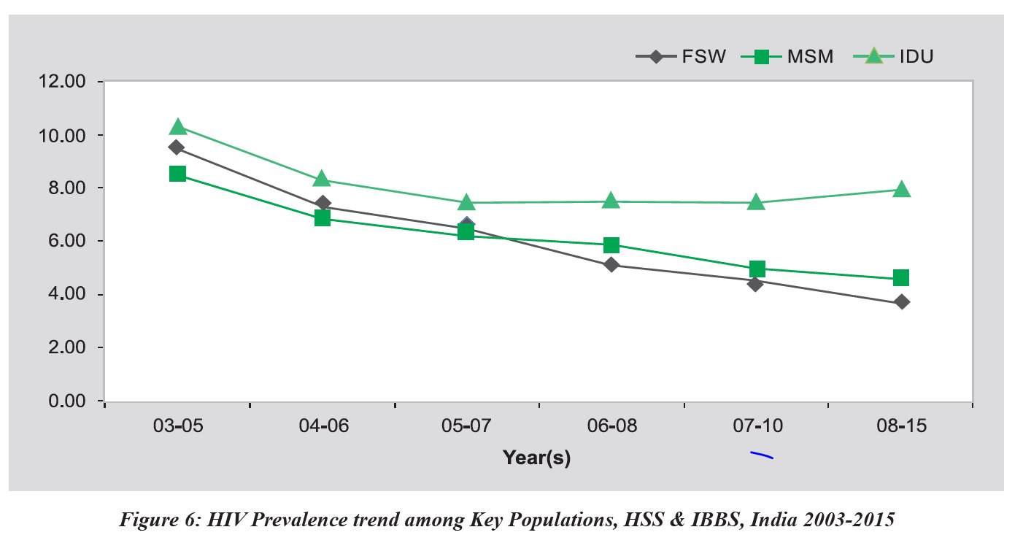
Successfully Scaled HIV prevention programs
India
Some Elements of Success
Government ownership – KP center of prevention response since second national strategic plan (2000 – 2006).
Gradually expanded to national program – cities → highest burden districts → highest burden states → nationwide.
Implemented by civil society – large scale social contracting. Formal community engagement.
Comprehensive service package and program intensity defined and monitored.
Data for decision making: size estimates and mapping data, high quality monitoring data and regular surveys.
Pop | Number | Coverage
FSW | 634,000 | ~75%
HR-MSM | 112,000 | ~ 75%
PWID | 199,000 | ~ 75%
TG | 32,000 | ~ 75%

Slide 9
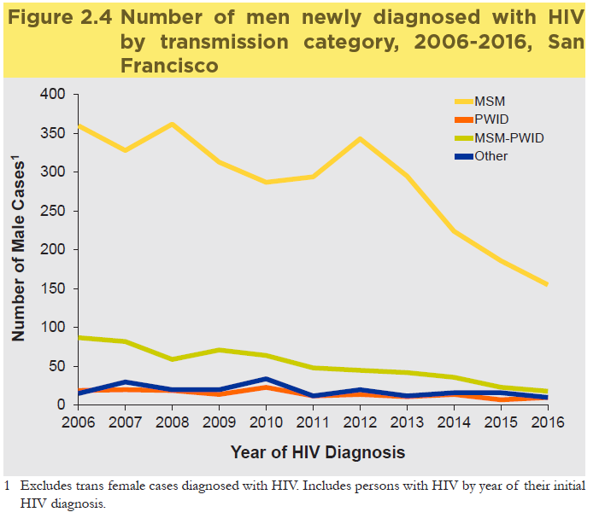
PrEP in San Francisco
Some Elements of Success
Longstanding community engagement and comprehensive service delivery to community
Responsive services to identified barriers
Community norms on acceptance of PrEP
Roll out of PrEP in 2014 addressing barriers
Easier access – nurse led delivery
Same day PrEP initiation
Full benefits navigation (reducing cost barriers)
Active f/u
Report in 2016
1,252 screened, 95.5 % PrEP acceptance
Reported high adherence
STI prevalence rates unchanged (no
change in condom use)
0 HIV infections in PrEP users compared
to 82 sero-conversions in 16 month f/u

Slide 10
Summary
4 of 5 examples I showed of success scaled programs were in KPs:
PWID - Australia
MSM – San Francisco
SW - Cambodia
KPs - India
Early successes with limited tool kit and limited evidence base
Variable experience in the missing populations:
30 years of experience in key-populations – the “what” and “how” are known
AGYW, young men are new - limited evidence of scaled success
We have more prevention tools now.

Slide 11
Conclusions
Our collective failure in prevention is not tool-related.
No magic bullet
Must address the multilayer, complex, difficult and mundane implementation issues
Government leadership, ownership, accountability
Community involvement / mobilization / ownership
Access platform(s)
Scale, intensity, coverage
Population specific defined package for all implementers
Addressing structural barriers
Data for management / advocacy
Funding
Underlying success factors

